Slide 1

Airplane Reservation System using Java
Welcome to our presentation on the development of an airplane reservation system using Java. This presentation will provide an overview of the system's architecture, design, and key functionalities
MADE BY:-
AGRIM SHARMA,AKSH PRAJAPATI,ABHSIHEK THAKUR,AKSHAT KUMAR GOND

Slide 2
Introduction to the Reservation System
System Overview
Key Features
The system allows users to browse available flights, select seats, make payments, and manage their reservations.
The system will be user-friendly, scalable, and secure to meet the needs of modern travelers.

Slide 3
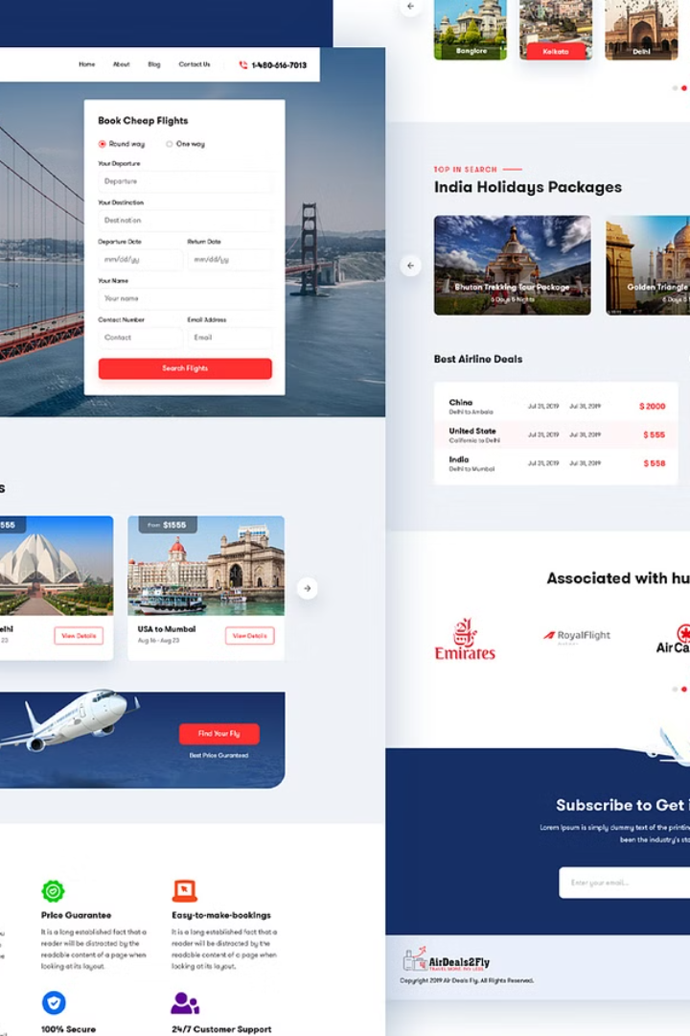
User Interface Design
Intuitive Design
Responsive Design
The interface will provide an easy-to-navigate and user-friendly experience.
The design will adapt to various screen sizes and devices, ensuring optimal user experience.
Accessibility Features
The system will be accessible to users with disabilities, following accessibility guidelines.

Slide 4
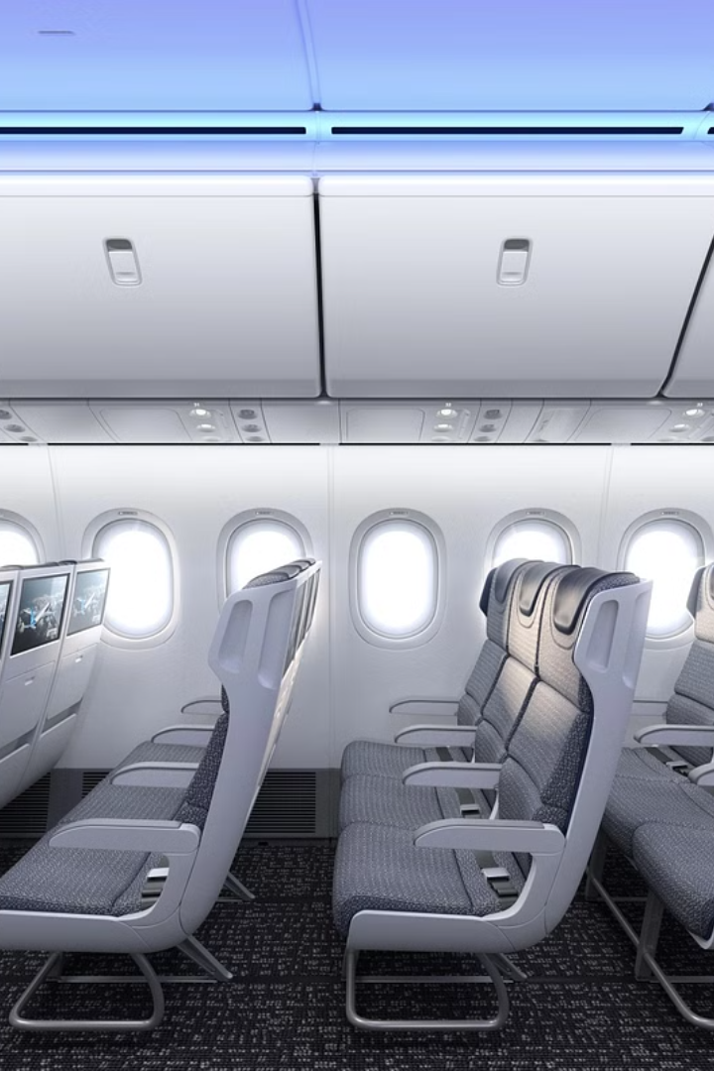



Booking Flights and Seat Selection
Flight Search
Users can search for flights by date, origin, destination, and other criteria.
Seat Selection
Users can choose their preferred seats based on availability and pricing.
Booking Confirmation
Once booked, users receive a confirmation email with reservation details.

Slide 5
Payment Processing
Secure Payment Gateway
1
The system will use a secure payment gateway to process transactions.
Multiple Payment Options
2
Users can choose from various payment methods, including credit cards, debit cards, and mobile wallets.
Transaction Confirmation
3
Users receive real-time confirmation of their successful payment.

Slide 6
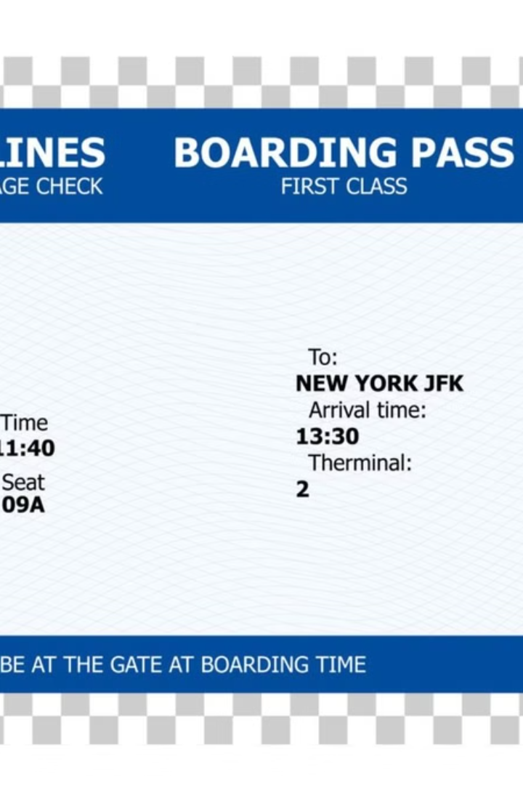
Reservation Management
1
Reservation Viewing
Users can view their reservation details, including flight information and seat selection.
2
Reservation Modification
Users can modify their reservations if needed, subject to availability and fees.
3
Reservation Cancellation
Users can cancel their reservations, and receive refunds based on cancellation policies.

Slide 7



Data Storage and Retrieval
Database Design
1
The system will use a relational database to store and manage reservation data.
Data Security
2
Data will be encrypted and protected with strong security measures.
Data Backup and Recovery
3
Regular backups will be implemented to ensure data integrity and availability.

Slide 8



Conclusion and Future Enhancements
System Benefits
The system offers a streamlined and convenient experience for users.
Future Enhancements
We plan to add features like real-time flight tracking and personalized recommendations.

Slide 9


